Slide 1
Concurrent Control
— Chapter 18
2021年12月
叶文
yewen@bupt.edu.cn
School of Computer Science (National Pilot Software Engineering School)

Slide 2
C, C++, Java programs
query
程 序 编 译 / 编译器
词法/语法/语义分析
Query processing / DBMS
扫描和语法/语义分析
中间代码生成
关系代数表达式&查询树
Chapter15, 16
(中间)代码优化
查询优化
(§16)
(优化后)查询执行计划
目标代码生成
查询代码生成
(§15)
目标程序代码
查询计划执行的代码
process / thread
事务处理 / DBMS
transaction
程序执行 /
进程管理
&进程调度
并发控制
死锁处理
事务管理
&事务调度
并发控制
恢复技术
Chapter 17, 18, 19
死锁处理
OS
(§19)
(§17)
(§18)
Fig. 18.0.1

Slide 3
Outline
根据可串行化基本原理, 采用以下机制控制多个进程对共享数据的互斥访问：
(Reader-writer model)
lock-based protocols (18.1)
multi- granularity schemes (多粒度，18.3)
multi-version schemes (多版本，e.g. 读写分离，18.6)
timestamp-based protocols (§18.4)
validation-based protocols (验证，18.5) }
deadlock handling (§18.2)
deadlock prevention
deadlock detection and recovery
Insert and Delete Operations
Concurrency in Index Structures
Concurrent control schemes
deadlock

Slide 4
18.1 Lock-based Protocol
Principles：基于reader-writer model，用二元信号量lock，控制并发事务{Ti}对共享数据Q的访问
对多种粒度的数据项Q设置锁
T_{i}存取Q时，先向DBMS申请对Q加锁
如果此时Q未被其它事务加锁，则T_{i}加锁成功，继续执行对Q的访问
如果此时Q已经被其它事务加锁，则T_{i}等待，直至Q上的锁被释放， T_{i}获得锁后继续执行
T_{i}执行完对Q的操作后，解锁Q
DBMS根据lock-compatibility matrix将lock授予请求的事务，reader-writer model
事务执行过程: 申请锁——加锁——读写数据项——解锁

Slide 5
Lock-based Protocol
共享数据Q
1.逻辑单元
属性值，属性值集合，元组，关系，索引项，整个索引，数据库DB
2. 物理单元
数据页(page，4K/8K)，索引页，数据块extent, DB file

Slide 6
Locks
A lock is a mechanism to control concurrent access to a data item
a transaction is allowed to access a data item only if it is currently holding a lock at that item
Data items can be locked in two modes
exclusive (X) mode
Data item can be both read as well as written
X-lock is requested using lock-X instruction
shared (S) mode
Data item can only be read
S-lock is requested using lock-S instruction
Lock primitives
lock-S(Q), unlock-S(Q)； lock-X(Q), unlock-X(Q);
Lock requests are made to the concurrency-control manager by the programmer. Transaction can proceed only after request is granted.

Slide 7
Locks (cont.)
Concurrency-control manager/scheduler in DBMS grants lock to transactions who want to access Q according to lock-compatibility matrix
assuming that T_{i} requests a lock of mode A on data item Q on which another transaction T_{j} currently holds a lock of mode B, if T_{i} can be granted a lock of mode A, then mode A is compatible with mode B
T_{j}
T_{i}
B
 | S | X
S | true | false
X | false | false
A
Fig.18.1 Lock-compatibility matrix

Slide 8
Locks (cont.)
In accordance with Fig.18.1, several shared locks can be held simultaneously (by different transactions) on shared data item Q
When T_{i} requests a lock of mode A to operate on data item Q, e.g. S(Q) related to read(Q), while Q is already locked in a incompatible mode B byT_{j}, e.g. X(Q) related to write(Q), then
T_{i} must wait until the lock in mode B held by T_{j} is released, the lock is then granted to T_{i}
If a lock cannot be granted, the requesting transaction is made to wait till all incompatible locks held by other transactions have been released. The lock is then granted

Slide 9
Locks (cont.)
Procedures of T_{i}’s executing to access a data item Q
(1) other operations in T_{i}
(2) request a lock S(Q) or X(Q), by the primitive lock-S(Q) or lock-X(Q)
(3) wait for concurrency-control manager’s granting of the lock requested
(4) whenever obtaining the lock, i.e., lock request is granted, make access on Q
(5) after finishing data access on Q, release lock on Q, by unlock-S(Q) or unlock-X(Q)
(6) other operations

Slide 10
Example
T_{i}
T_{j}
lock-X(Q)
read(Q)
lock-S(R)
read(R)
unlock(R)
write(Q)
lock-X(R)
waiting
…
obtaining the lock
write(R)

Slide 11
Example 1
T₁: transfer $50 from account-B to account-A, Fig.18.2
T₂: display the total amount of A and B, Fig.18.3
T₁ and T₂ unlock data item A and B immediately after its final access of that data
Initially, A=100, B=200
T₁: lock-X(B);
read(B);
B:=B-50;
write(B);
unlock(B);
lock-X(A);
read(A);
A:=A+50;
write(A);
unlock(A);
T₂: lock-S(A);
read(A);
unlock(A);
lock-S(B);
read(B);
unlock(B);
display(A+B)

Slide 12
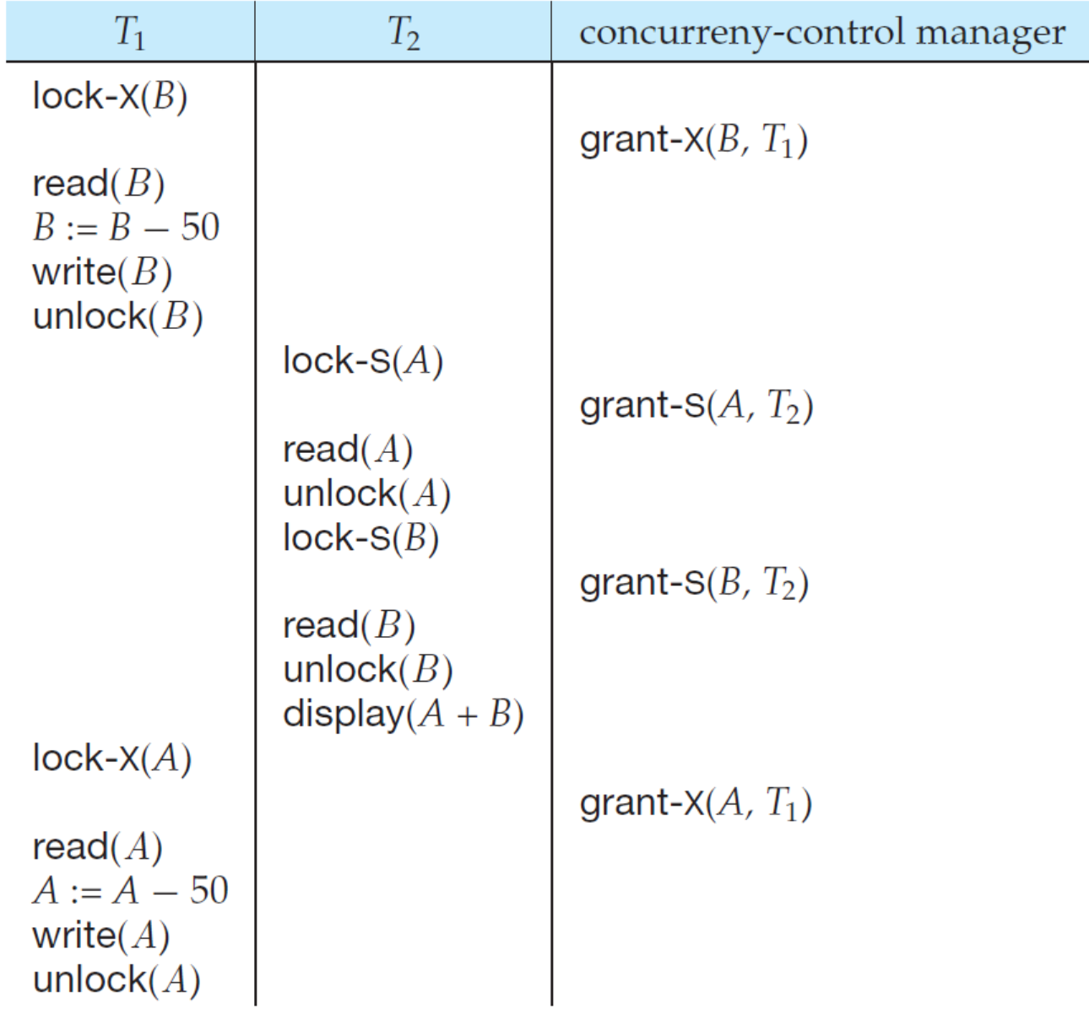
For the concurrent schedule S₁ (given in Fig.15.4) on T₁ and T₂ , an inconsistent result display(A+B) = 250 exist, why?
T₁ unlocked data item B too early, as a result of which T₂ saw a inconsistent state
+

Slide 13
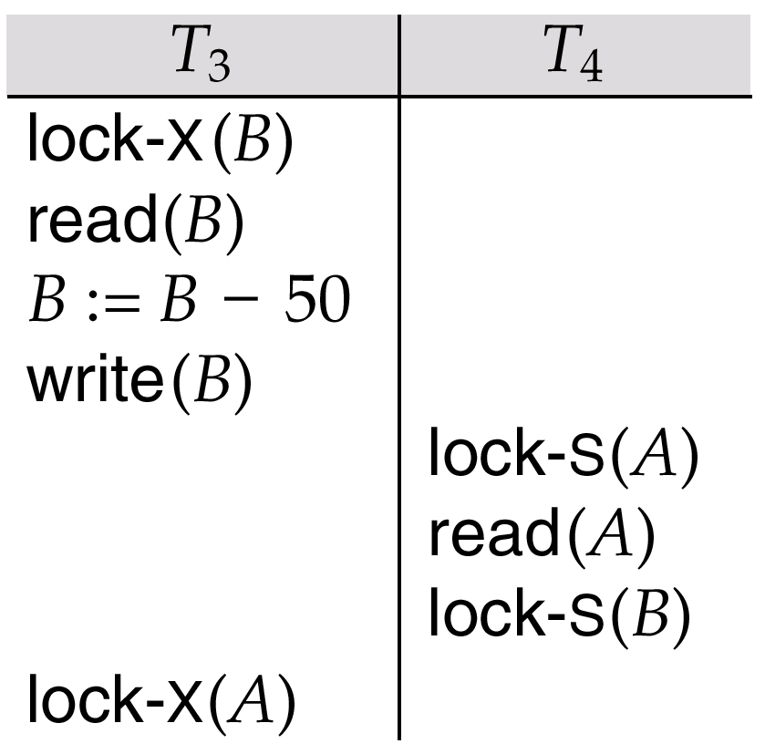
Example 2
T₃: transfer $50 from account-B to account-A, Fig.18.5
T₄: display the total amount of A and B, Fig.18.6
T₃ and T₄ unlock data item A and B at the end of transaction
Initially, A=100, B=200
The concurrent schedule S₂ (given in Fig.18.7) on T₃ and T₄ leads to deadlock
A
T₃
T₄
B

Slide 14
Locks (cont.)
The potential for deadlock exists in most locking protocols. Deadlocks are a necessary evil.
Starvation is also possible if concurrency control manager is badly designed. For example:
E.g.1, a transaction, as a writer, may be waiting for an X-lock on an item, while a sequence of other transactions, as readers, request and are granted an S-lock on the same item
several reader transactions read the shared data item continuously, while one writer transaction has to waiting
E.g. 2, the same transaction is repeatedly selected as the victim, and rolled back due to deadlocks, by the deadlock handling scheme in DBMS
Concurrency control manager can be designed to prevent starvation

Slide 15
Locking protocol
As revealed by the above examples, in lock-based schemes, the orders of granting locks to and revoking locks from transactions must be limited to avoid inconsistent DB states and transaction deadlock
Locking protocol
set of rules followed by all transactions while requesting and releasing locks
Locking protocols restrict the set of possible schedules, and lead to a subset of all possible conflict serializable schedules

Slide 16
Two Phase Locking Protocol/2PL
In accordance with 2PL, each transaction T_{i} issues lock and unlock requests in two phases
growing phase
T_{i} may obtain locks, but may not release any locks
shrinking phase
T_{i} may release locks, but may not obtain any locks
when T_{i} begins, it enters growing phase
when T_{i} releases its first lock by unlock, it enters shrinking phase, and is not allowed to apply for locks, i.e. not allowed to enter growing phase

Slide 17
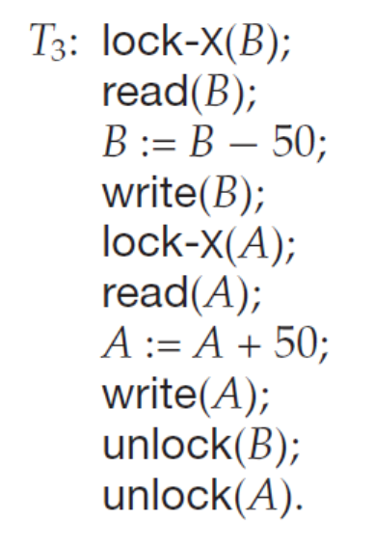
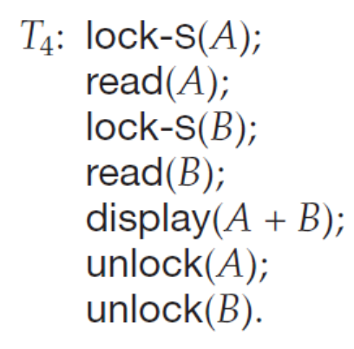
Examples
T₂: lock-S(A);
read (A);
unlock(A);
lock-S(B);
read (B);
unlock(B);
display(A+B)
transaction following 2PL
transaction not following

Slide 18
Two Phase Locking Protocol/2PL
The protocol assures serializability. It can be proved that the transactions can be serialized in the order of their lock points
the point where a transaction acquired its final lock
Lock point
the point in the transaction/schedule where the transactions has obtain its final lock, but has not yet unlock any locks
or, releases its first lock by unlock
E.g. lock-point in T₅ in Fig.18.0.1

Slide 19
Example
T₅
Lock-X(A)
read (A)
Lock-S(B)
read (B)
Unlock (B)
write (A)
Unlock (A)
growing
phase
lock
point
Shrinking
phase
Fig.18.0.1 Partial schedule under two-phase locking

Slide 20
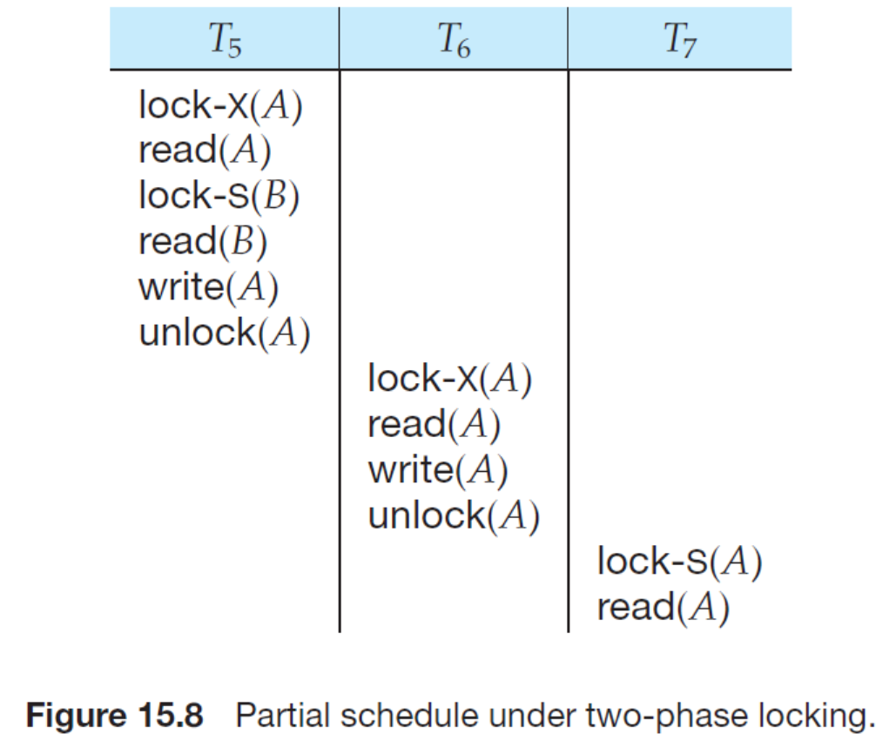
18.02

Slide 21
2PL Properties
2PL guarantees conflict serializability
generates conflict serializable concurrent schedules
2PL does not ensure freedom from deadlock
2PL does not avoid cascading rollback

Slide 22
Two Phase Locking Protocol/2PL
Given a concurrent schedule S in line with 2PL, S is equivalent to a serial schedule S’, such that
the ordering of lock points of each transactions in S is the same as the ordering of transactions in S’
E.g. S3 in Fig.18.0.3 is conflict serializable, and equivalent to <T₅; T₆’ >
the lock point of T₅ is before the lock point of T₆’

Slide 23
Example
T₅
Lock-X(A)
read (A)
Lock-S(B)
read (B)
Unlock (B)
write (A)
Unlock (A)
T₆’
Lock-X(B)
read (B)
write (B)
Unlock (B)
LP5
Lock-X(B)
waiting
LP6’
Fig. 18.0.3 A concurrent schedule S₃ under 2PL, equivalent to <T₅; T₆’ >

Slide 24
Construct the schedules in line with 2PL
给定若干事务, 构造满足2PL的并发调度S
为各事务添加加锁和解锁操作，各事务应满足2PL要求，即事务内部分为生长和收缩2个阶段
根据各事务的锁点位置和锁的互斥性 (相容关系)，安排各事务的并发执行
S中各事务的growing phase和shrinking phase 应尽可能错开，不允许访问同一数据的2个事务（冲突事务）同时处于growing phase
E.g. A concurrent schedule S4 in Fig.18.0.4

Slide 25
T₅
Lock-X(A)
read (A)
Lock-S(B)
read (B)
Unlock (B)
write (A)
Unlock (A)
T₆’
Lock-X(B)
read (B)
write (B)
Unlock (B)
G
G
S
S
S4 is equivalent to <T6’;T5>
Fig.18.0.4 A concurrent schedule S4 under 2PL protocol constraints

Slide 26
Example
Construct a concurrent schedule that is equivalent to <T₇; T₈>
step1. 分别为T7和T8加锁操作, 构成T₇’和T₈’
T₇
read (A)
read (B)
write (A)
T₇’
Lock-X(A)
read (A)
Lock-S(B)
read (B)
Unlock (B)
write (A)
Unlock (A)
T₈
read (B)
write (B)
read (C)
T₈’
Lock-X(B)
read (B)
Lock-S(C)
write (B)
read (C)
Unlock (B)
Unlock (C)
Fig.18.0.5-1 A concurrent schedule S₅

Slide 27
step2. 根据锁的相容性构造调度，假设T₇’的锁点先于T₈’的锁点
T₇’
Lock-X(A)
read (A)
Lock-S(B)
read (B)
Unlock(B)
write (A)
Unlock(A)
T₈’
Lock-X(B)
read (B)
Lock-S(C)
write (B)
read (C)
Unlock(B)
Unlock(C)
Fig.18.0.5-1 A concurrent schedule S₅

Slide 28
Strict 2PL protocol
There are two types of enhanced 2PL protocols, that is, strict 2PL and rigorous 2PL
Strict (严格) 2PL protocol
all X-locks taken by a transaction are held until that transaction commits/aborts, that is, all X-locks can only be unlocked at the end of the transaction
leading to cascadeless, recoverable and serializable schedules
e.g. schedule S₆ in Fig. 18.0.6
T₁
Lock-X(A)
read (A)
Lock-S(B)
read (B)
Unlock(B)
write(A)
…..
Unlock(A)
growing phase
lock
point
shrinking phase
Fig. 18.0.6 A schedule S₆ under strict 2PL

Slide 29
Rigorous 2PL protocol
Rigorous (强制) 2PL protocol
all X-locks and S-locks taken by a transaction are held until that transaction commits/aborts
leading to transactions are serialized in the order in which they commit
ensures recoverability and avoids cascading roll-backs
e.g. schedule S₇ in Fig.18.0.7
T₁
Lock-X(A)
read (A)
Lock-S(B)
read (B)
write (A)
…
Unlock (A)
Unlock (B)
growing phase
Most databases implement rigorous two-phase locking, but refer to it as simply two-phase locking
lock
point
shrinking phase
Fig.18.0.7 A schedule S₇ under rigorous 2PL

Slide 30
Locking Protocols
Given a locking protocol (such as 2PL)
A schedule S is legal under a locking protocol if it can be generated by a set of transactions that follow the protocol
A protocol ensures serializability if all legal schedules under that protocol are serializable

Slide 31
Lock Conversions【略】
Two-phase locking protocol with lock conversions
Growing Phase:
can acquire a lock-S on item
can acquire a lock-X on item
can convert a lock-S to a lock-X (upgrade)
Shrinking Phase
can release a lock-S
can release a lock-X
can convert a lock-X to a lock-S (downgrade)
This protocol ensures serializability

Slide 32
Automatic Acquisition of Locks
A transaction T_{i} issues the standard read/write instruction, without explicit locking calls.
The operation read(D) is processed as:
if T_{i} has a lock on D
then
read(D)
else begin
if necessary wait until no other
transaction has a lock-X on D
grant T_{i} a lock-S on D;
read(D)
end

Slide 33
Automatic Acquisition of Locks (Cont.)
The operation write(D) is processed as:
if T_{i} has a lock-X on D
then
write(D)
else begin
if necessary wait until no other trans. has any lock on D,
if T_{i} has a lock-S on D
then
upgrade lock on D to lock-X
else
grant T_{i} a lock-X on D
write(D)
end;
All locks are released after commit or abort

Slide 34
Implementation of Locking
A lock manager can be implemented as a separate process to which transactions send lock and unlock requests
Transactions can send lock and unlock requests as messages
The lock manager replies to a lock request by sending a lock grant messages (or a message asking the transaction to roll back, in case of a deadlock)
The requesting transaction waits until its request is answered
The lock manager maintains a data-structure called a lock table to record granted locks and pending requests
The lock table is usually implemented as an in-memory hash table indexed on the name of the data item being locked

Slide 35
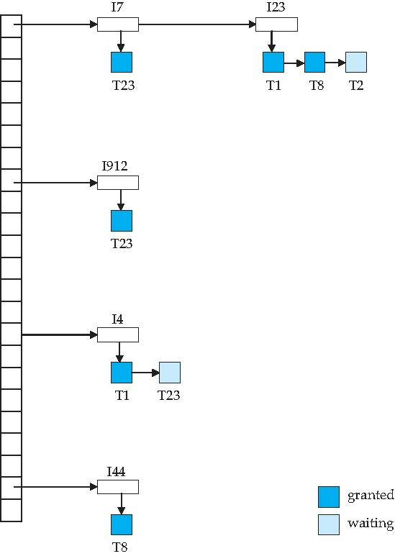
Lock Table
Dark blue rectangles indicate granted locks; light blue indicate waiting requests
Lock table also records the type of lock granted or requested
New request is added to the end of the queue of requests for the data item, and granted if it is compatible with all earlier locks
Unlock requests result in the request being deleted, and later requests are checked to see if they can now be granted
If transaction aborts, all waiting or granted requests of the transaction are deleted
lock manager may keep a list of locks held by each transaction, to implement this efficiently
s s x
data item: I7, I23, I912, I4, I44

Slide 36
Graph-Based Protocols【略】
Graph-based protocols are an alternative to two-phase locking
Impose a partial ordering → on the set D = {d₁, d₂ ,..., d_{h}} of all data items.
If d_{i} → d_{j} then any transaction accessing both d_{i} and d_{j} must access d_{i} before accessing d_{j}.
Implies that the set D may now be viewed as a directed acyclic graph, called a database graph.
The tree-protocol is a simple kind of graph protocol.

Slide 37
18.2 Deadlock Handling【略】
System is deadlocked if there is a set of transactions such that every transaction in the set is waiting for another transaction in the set
Deadlock handling
refer to Operating System Concepts

Slide 38
Principles of deadlock handling
if deadlock occurs
then { (mutual exclusion)
and (hold and wait )
and (no preemption)
and (circular wait )
}
/(等价逆否命题) Equivalent converse-negative proposition
if { not (mutual exclusion) //multiple-version scheme in DBS, 多版本机制
or not (hold and wait )
or not (no preemption)
or not (circular wait ) }
then deadlock will not occur

Slide 39
Principles of deadlock handling
通过破坏四个必要条件之一，阻止死锁的发生
实际系统中主要采取破坏hold and wait 和circular wait的方法
三种死锁处理机制
死锁的预防
死锁的避免
死锁的检测与恢复
DBMS采取
deadlock prevention
deadlock detection and recovery

Slide 40
Deadlock Handling
Deadlock prevention protocols ensure that the system will never enter into a deadlock state. Some prevention strategies:
require that each transaction locks all its data items before it begins execution (pre-declaration)
资源预先分配
impose partial ordering of all data items and require that a transaction can lock data items only in the order specified by the partial order (graph-based protocol)
资源有序申请、使用

Slide 41
More Deadlock Prevention Strategies
wait-die scheme — non-preemptive
Older transaction may wait for younger one to release data item.
Younger transactions never wait for older ones; they are rolled back instead.
A transaction may die several times before acquiring a lock
wound-wait scheme — preemptive
Older transaction wounds (forces rollback) of younger transaction instead of waiting for it.
Younger transactions may wait for older ones.
Fewer rollbacks than wait-die scheme.
In both schemes, a rolled back transactions is restarted with its original timestamp.
Ensures that older transactions have precedence over newer ones, and starvation is thus avoided.

Slide 42
Deadlock prevention (Cont.)
Timeout-Based Schemes:
A transaction waits for a lock only for a specified amount of time. After that, the wait times out and the transaction is rolled back.
Ensures that deadlocks get resolved by timeout if they occur
Simple to implement
But may roll back transaction unnecessarily in absence of deadlock
Difficult to determine good value of the timeout interval.
Starvation is also possible

Slide 43
Deadlock Detection
Deadlocks can be described as a wait-for graph, which consists of a pair G = (V, E)
Vertices: transactions
Edge from T_{i} →T_{j}.
a directed edge from T_{i} to T_{j} implies that T_{i} is waiting for T_{j} to release a data item
T_{i} is waiting for a lock held in conflicting mode byT_{j}
When T_{i} requests a data item currently being held by T_{j}, then the edge T_{i} → T_{j} is inserted in the wait-for graph. This edge is removed only when T_{j} is no longer holding a data item needed by T_{i}.

Slide 44
Deadlock Detection
The system is in a deadlock state if and only if the wait-for graph has a cycle.
Invoke a deadlock-detection algorithm periodically to look for cycles.
Wait-for graph without a cycle
Wait-for graph with a cycle
死锁恢复：
回滚、撤销处于环路中占有资源的进程，如T₁₈

Slide 45
Deadlock Recovery
When deadlock is detected :
Some transaction will have to rolled back (made a victim) to break deadlock cycle.
Select that transaction as victim that will incur minimum cost
Rollback -- determine how far to roll back transaction
Total rollback: Abort the transaction and then restart it.
Partial rollback: Roll back victim transaction only as far as necessary to release locks that another transaction in cycle is waiting for
Starvation can happen (why?)
One solution: oldest transaction in the deadlock set is never chosen as victim

Slide 46
oepnGauss数据库事务死锁检测与处理
1.针对表级锁的等待队列，进行环路检测
2.回滚某些处于环路中的事务

Slide 47
Example
系统在某一时刻的资源分配表和事务等待表如下图所示，问：该系统中是否存在死锁？如果存在，终止哪个事务解决死锁问题所付出的代价最小？
资源分配表
事务等待表
事务号 | 数据对象号
T₁ | Q₁
T₂ | Q₃
T₃ | Q₂
T₃ | Q₅
T₄ | Q₄
事务号 | 数据对象号
T₁ | Q₂
T₂ | Q₁
T₃ | Q₃
T₃ | Q₄
T₄ | Q₅
占有边
请求边

Slide 48
资源分配表
事务等待表
事务号 | 数据对象号
T₁ | Q₁
T₂ | Q₃
T₃ | Q₂
T₃ | Q₅
T₄ | Q₄
事务号 | 数据对象号
T₁ | Q₂
T₂ | Q₁
T₃ | Q₃
T₃ | Q₄
T₄ | Q₅
占有边
请求边
Q₂
Q₄
T₁
T₂
T₃
T₄
Q₁
Q₃
Q₅

Slide 49
17.8 Transaction Isolation Levels/18.9 Weak Levels of Consistency
多个并发事务执行时，为保证数据一致性/正确性，
避免读—写冲突
避免写—写冲突
允许多个事务同时读
机制
对共享数据加锁locking，实现serializable调度
strict/ rigorous 2PL
缺点
事务并发程度低，执行慢
T_{i}
begin-trans
lock-X(Q)
W(Q)
commit
deferred
T_{j}
request
lock-X(Q)
be granted
lock-X(Q)
W(Q)
/R(Q)

Slide 50
Weak Levels of Consistency
实际数据库系统中，引入弱一致性，weak levels of consistency
允许一定程度读—写冲突
仍然禁止写—写冲突
不要求serializable 调度，部分牺牲一致性，提高并发程度
Weak levels of consistency / Isolation Levels(隔离级别)
Serializable
Repeatable read, Read committed, Read unucommitted
带来的不一致性：丢失修改， 读脏数据，不可重复读，幻象
Snapshot isolation

Slide 51
Weak Levels of Consistency
Some applications are willing to live with weak levels of consistency, allowing schedules that are not serializable
e.g., (读-写) a read-only transaction that wants to get an approximate total salary of all instructors
such transactions need not be serializable with respect to other transactions
Tradeoff accuracy for performance
lower degrees of consistency useful for gathering approximate information about the database

Slide 52
Levels of Consistency/Isolation Levels in SQL-92
Serializable — default
Repeatable read — only committed records to be read, repeated reads of same record must return same value
so read locks should be retained
However, a transaction may not be serializable – it may find some records inserted by a transaction but not find others
Read committed — only committed records can be read, but successive reads of record may return different (but committed) values
Read uncommitted — even uncommitted records may be read

Slide 53
Levels of Consistency/Isolation Levels in SQL-92
Warning: some database systems do not ensure serializable schedules by default
e.g., Oracle and PostgreSQL by default support a level of consistency called snapshot isolation (not part of the SQL standard)
In many database systems, read committed is the default consistency level
has to be explicitly changed to serializable when required
set isolation level “serializable”

Slide 54
并发调度中的数据不一致性
在Repeatable read, Read committed, Read uncommitted 三种隔离级别下，多个事务并发执行时，调度不满足可串行性（Serializable）要求，会发生如下四种情况的数据不一致
丢失修改，写-写错误
读脏数据，写-读错误
不可重复读，读-写错误
幻象

Slide 55
丢失修改/ 写-写冲突
race condition
事务T₁、T₂读入同一数据并进行修改。T₂首先提交，然后T1再提交。T₁提交的结果破坏了T₂提交的结果，导致T₂的修改结果丢失
E.g. 订票系统，2个用户T₁、T₂对车票余额X做修改
问题
最终的余额X=8, 不是正确值X=7
原因
2个事务对同一个数据项X同时修改
解决方法：利用互斥锁X-lock
Read(X)
X:=X-2=8
Write(X)
T₁
订2张
X=10
X=9
X=8
T₂
订1张
Read(X)
X:=X-1=9
Write(X)

Slide 56
读脏数据/写-读-撤销冲突
事务T₁修改某一数据X，并将结果写回磁盘文件（但事务未提交）；之后，事务T₂读入（被T₁修改过的）同一数据X后， T₁由于某种原因被回滚撤销，其已修改过的X恢复成原值，使得T₂读取的X的值与数据库中数据不一致
脏数据：未提交、其后失效的数据
E.g. 订票系统
不可恢复调度
T₁
先订后退
Read(X)
X:=X-2
Write(X)
rollback
X=10
X=8
X=10
T₂
Read(X)
使用未提交到DB中的（无效）数据8进行后续处理
X=8

Slide 57
读脏数据（续）
实际数据库系统中，读脏数据在一般情况下是不允许，但在某些特殊情况下是允许的，以提高事务并发执行程度
E.g.1 对每笔存款账户计息——不允许读脏数据
T₁: 某个客户向自己的存款账户中新加入部分钱，但随后由于某种原因撤销加入的钱
T₂: 对全部存款账户进行计息操作
E.g.2 对全部存款账户进行统计，在此基础上进行预测
T₁: 某个客户向自己的存款账户中新加入部分钱，但随后由于某种原因撤销加入的钱
T₂: 对全部存款账户进行统计（avg、max、min），预测未来走势
允许读脏数据，读取极少数储户的脏数据对整体的统计、预测结果影响不大

Slide 58
不可重复读/读-写冲突
事务T₂读取某一数据X后，事务T₁对其做了修改；当T₂再次读同一数据X时，得到的X值与前次不同
Read(X)
X:=X-2
Write(X)
commit
T₁
X=10
X=8
T₂
Read(X)
Read(X)
X=10
X=8

Slide 59
不可重复读（续）
E.g. 某公司向多个部门分发商品价目表
T₂: 分发事务
每次将价目表从DB中读取，传给1个部门；下一次再将价目表从DB中读出，再分发给下一个部门
T₁: 对价目表进行修改
在分发事务还没有结束时，即T₂还没有结束，如果T₁修改了价目表，导致分发给不同部门的价目表是不一致的
不允许！

Slide 60
幻象
事务T₂按一定条件读取某些数据后，事务T₁插入（删除）了一些满足这些条件的数据；其后，当T₂再次按相同条件读取数据时，发现多或少了一些记录
王五，23
T₁
insert
李四，24
李四，24
王五，23
张三，21
张三，21
T₂
select count(*)
where age>20
select count(*)
where age>20

Slide 61
幻象（续）
E.g. 某公司按照销售量排位进行奖励
T₂: 排位、奖励事务
T₁: 加入新的销售记录
初始时，销售记录为{(Tom,30), {Jerry,40}}, 排位奖励顺序为{Jerry, Tom};
如果加入新的销售记录(Tom,15), 则排位顺序变为{Tom, Jerry};

Slide 62
不同隔离级别下的数据不一致性
在数据库访问效率、速度、数据一致性方面合理平衡
隔离级别 | 描述 | 不一致现象
Read uncommitted 未提交读、脏读 | 允许读取未提交的记录 | 读脏数据 不可重复读 幻象
Read committed 提交读（SQL Server默认的隔离级别） | 只允许读取已提交的记录，但不要求可重复读（即不要求对同一数据项，每次读取的值是一样的） | 不可重复读 幻象
Repeatable Read 可重复读 | 只允许读取已提交的记录，并要求在1个事务对数据的2次读取之间，其它事务不能对该数据进行更新（从而保证每次读取的值是一样的） | 幻象
Serializable 可串行化 | 调度的执行等价于串行调度 | -----------

Slide 63
Read uncommitted
定义在该级别上的事务可以读取数据库中的任何数据，不管这些数据是否已经提交
e.g. 事务T₁持有互斥锁正在对数据项Q进行更新，设置为Read uncommitted的事务T₂可以并行地读取Q，不需要加锁；
如果其后事务T₁终止，并rollback所做过的对Q的修改操作，但T₂还是基于更新后的数据进行后续操作
设置为Read uncommitted的事务T₂读数据时不需要等待获得Q上的S锁，也不会对Q施加S锁
即T₂不受锁协议控制

Slide 64
连接T₁: 连接T₂:
set transaction isolation level READ UNCOMMITTED
begin tran
select SNAME from S
where SNAME=‘王红’
-----结果：姓名为‘王红的一个学生
begin tran
update S
set SNAME= =‘王红’
---修改全部学生姓名
select SNAME from S
where SNAME=‘王红’
----结果：姓名为‘王红的多个学生
commit
select SNAME from S
where SNAME=‘王红’
-----结果：姓名为‘王红的多个学生
commit tran
2个事务同时读写，不满足锁协议

Slide 65
Read committed
定义在该级别上的事务不允许读取其它事务未提交的数据
事务T₁持有互斥锁正在对数据项Q进行更新，设置为Read committed的事务T₂需要持有共享锁才能读取Q
必须受锁协议控制
设置为Read committed的事务T₂持有的共享锁在将访问结果数据返回给请求它的客户端后立即释放
T₂的S锁遵循strict 2PL
SQL Server 默认的隔离级别

Slide 66
连接T₁: 连接T₂:
set transaction isolation level READ COMMITTED
begin tran
select SNAME from S
where SNAME=‘王红’
-----只有一个学生姓名为‘王红
begin tran
update S
set SNAME= =‘王红’
---修改全部学生姓名
select SNAME from S
where SNAME=‘王红’
----受锁协议控制-阻塞，显示“正在执行批查询”
commit
-----显示所有学生姓名均为‘王红
commit

Slide 67
Repeatable Read
要求：同一个事务两次访问同一数据对象之间，其它事务不能修改该数据，以保证该事务2两次读取的Q的值是一样的
Repeatable Read的事务T₂在其生命周期中利用共享S锁，两次读取数据项Q，共享S锁直到T₂结束时才释放
共享S锁遵循rigurous 2PL
当其它事务T₁持有互斥锁需要对数据项Q进行更新时，被阻塞，等到T₂结束释放Q上的锁之后，才能开始更新Q
但Repeatable Read的事务T₂可能发生幻象！

Slide 68
连接T₁: 连接T₂:
set transaction isolation level REPEATABLE READ
begin tran
select SNAME from S
where SNAME like ‘王%’
-----只有一个学生姓名为‘王红
Insert into S values
(‘s08’, ‘王明’, 23, 1)
---插入新学生
select SNAME from S
where SNAME like ‘王%’
-----显示2个学生姓名为‘王红’、‘王明’
commit tran
---- 只封锁了S中现有数据，但没有封锁未来可能加入的数据，即允许其它事务，e.g. T₁，向S中新加入数据

Slide 69
Serializable
在可重复读的基础上，防止幻象发生！
执行结果等价于2个事务的串行执行
Repeatable Read的事务T₂在其生命周期中利用共享S锁，两次读取数据项Q，共享S锁直到T₂结束时才释放
共享S锁遵循rigurous 2PL
当其它事务T₁持有互斥锁需要对数据项Q进行更新时，被阻塞，等到T₂结束释放Q上的锁之后，才能开始更新Q
不仅封锁T₂读取的现有数据，还要封锁未来有可能满足条件的数据（防止插入、修改）

Slide 70
连接T₁: 连接T₂:
set transaction isolation level SERIALIZABLE
begin tran
select SNAME from S
where SNAME like ‘王%’
-----只有一个学生姓名为‘王红
Insert into S values
(‘s08’, ‘王明’, 23, 1)
---阻塞，显示“正在执行批查询”
select SNAME from S
where SNAME like ‘王%’
-----显示1个学生姓名为‘王红’
commit tran
---- 封锁了S中现有数据，封锁未来可能加入的数据，即不允许其它事务，e.g. T₁，向S中新加入数据

Slide 71
连接T₁: 连接T₂:
update S
set age=23
where S#=‘S1’
select *
from S (READPAST)
----SQL Server 跳过S#=‘S1’的学生，返回其
他全部学生

Slide 73
18.3 Multiple Granularity
Granularity of data items
the size of the data items to be accessed，or on which synchronization (e.g locking) is performed
Multiple granularity
allow data items, which are accessed by transactions, to be of various sizes
define a hierarchy of data granularities, where the small granularities are nested within larger ones
//在关系数据库中可以加锁的数据对象
1.逻辑单元
属性值、属性值集合、元组、关系、索引项、整个索引、整个数据库
2. 物理单元
数据页、索引页、数据块, file
SQL Server 加锁粒度/对象

Slide 74



自上而下四级加锁: DB– table- row- attribute
T₁
USE StuDB
Update Student
Set S#=S#+1
Where age>22
unlock
unlock
unlock
unlock
①
√
StuDB
②
④
√
S#
√
③
age=30
age=15
S#
√
age=25
age=10
table Student

Slide 75
Multiple Granularity
Multiple granularity can be represented graphically as a tree
refer to Fig. 18.15
Granularity of locking
level in tree where locking is done:
fine granularity (lower in tree), e.g. locking on tuple
coarse granularity (higher in tree): e.g. locking on database
Each node in the tree can be locked individually by lock primitives, e.g. lock_S(Q), lock_X(Q)
In addition, when a transaction locks a node in the tree explicitly, it implicitly locks all the node's descendants in the same mode

Slide 76
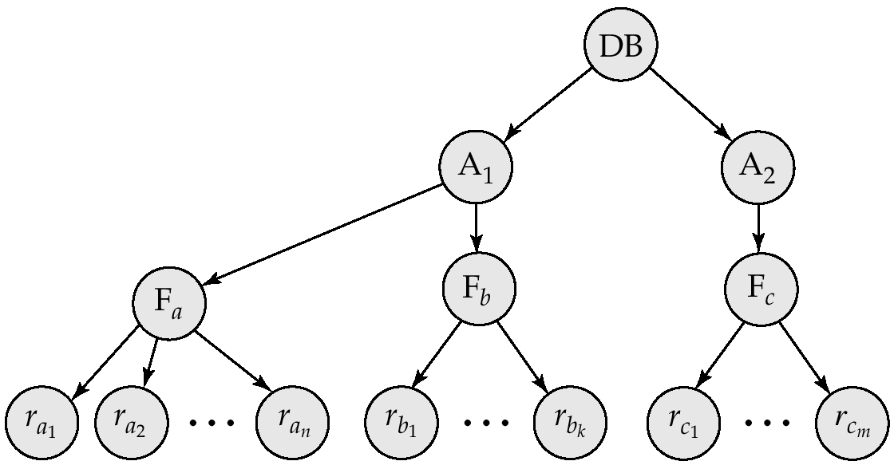
Example of Granularity Hierarchy
The levels, starting from the coarsest (top) level are
database
area, e.g. extent, page in SQL Server
file
record, tuple
T_{i}
T_{j}

Slide 77
Multiple Granularity (cont.)
For example, in Fig. 18.15 ( ), T_{i} has locked F_{b} in the exclusive mode explicitly
if T_{j} wishes to get a shared or exclusive lock on record r_{b1}, then it has to wait
if T_{k} wishes to lock the entire database, that is, to lock the root node, it will not succeed
Locking Granularity vs Concurrency and
fine granularity: high concurrency, high locking overhead
coarse granularity: low locking overhead, low concurrency
// 锁粒度与事务并发执行的程度和 DBMS并发控制的开销密切相关
— 锁粒度大，系统中被加锁的数据项少，事务并发执行度低，DBMS并发控制开销小
— 锁粒度小，被加锁的数据项多，事务并发度高，并发控制开销大
实际数据库系统中，DBMS自动为事务访问的数据项选择加锁粒度
说明
从并行效率和管理成本角度，大多数数据库系统的最小加锁粒度是行级锁

Slide 78
transaction T_{i}
update Student
set grade=4
where age>10
transaction T_{j}
update Student
set grade=6
where age < 5
表级锁
表级锁
Student
行级锁
grade | ID | name | age
1 | 21 | 1 | 12
2 | 22 | 2 | 7
3 | 0 | 3 | 8
6 | 4 | 3 | 1
…………
12 | 2 | 7 | 3
23 | 4 | 8 | 9
行级锁

Slide 79
Intention Lock Modes
资源树( )中，如果对较低级别的某个结点资源加锁，e.g. locking on tuples in a table, 从树根到该结点的直接父节点必须设置体现出该加锁模式的意向锁，e.g. table and DB, 以避免2个事务因加锁不同级别的资源而产生潜在的冲突
If a node is locked in an intension mode, explicit locking is being done at a lower level of the tree
intension locks are put on all the ancestors of a node before that node is locked explicitly

Slide 80
Intention Lock Modes
In addition to S and X lock modes, there are three additional lock modes with multiple granularity:
intention-shared (IS)
if a node is locked in a IS mode, then explicit locking is being done at a lower level of the tree, but only with shared
intention-exclusive (IX):
if a node is locked in a IX mode, then explicit locking is being done at a lower level of the tree, but with exclusive or shared locks
shared and intention-exclusive (SIX):
if a node is locked in a SIX mode, //refer to next two slides
the subtree rooted by that node is locked explicitly in shared mode
and explicit locking is being done at a lower level with exclusive-mode locks.

Slide 81
Intention Lock Modes
Intention locks allow a higher level node to be locked in S or X mode without having to check all descendent nodes.
DB: SIX
SIX
table1: S
S
S
tuple: X
X
X
table2: S
tuple: X
问题：1个、全部/多个子树？

Slide 82
update table1
set A=A+1
where A>10
update table1
set A=A+1;
select * from table2
DB: SIX
DB: IX
table1: S
table1: X
tuple: X , A=30
table2: S
table2: S
tuple: X

Slide 83
Intention Lock Modes
S, X:
局部, e.g. tuple
IS, IX, SIX
整体, e.g. DB, table
Assuming that T_{i} requests a lock of mode A on data item Q on which another transaction T_{j} currently holds a lock of mode B, if T_{i} can be granted a lock of mode A, then mode A is given by the compatibility matrix
refer to Fig. 18.16

Slide 84
Compatibility Matrix with Intention Lock Modes
现有T_{j}
E.g.
T_{i} want to access on the table student;
T_{j} is now accessing on student
请求T_{i}
DB
table
row
X:
update
insert
bulk insert
S, X: 局部
IS, IX, SIX: 整体

Slide 85
IS on DB
IS on table
S on tuple
IS on DB
S on table
IX/SIX on DB
IX on table
X on tuple
IX/SIX on DB
X on table
select ID
from student
where age>0
select ID
from student
update student
set ID:=ID+1
where age >20
delete
from student
where age>0
update student
set ID:=ID+1
delete
from student

Slide 86
Multiple Granularity Locking Scheme
Locks are acquired in root-to-leaf order, whereas they are released in leaf-to-root order
//加锁按自顶向下（根到叶）的顺序，释放锁按照自底向上（叶到根）的顺序
Transaction T_{i} can lock a node Q, using the following rules:
// Exp. 数据对象：Q: student, root/parent of Q: DB, children of Q: row in student
1. the lock compatibility matrix must be observed
2. the root of the tree, e.g. DB, must be locked first, and may be locked in any mode, e.g. IS, IX, SIX
3. a node Q, e.g. student, can be locked by T_{i} in S or IS mode only if the parent of Q, e.g. DB, is currently locked by T_{i} in either IX or IS mode
T_{i} 需要读取Q=student，加S锁，或读取Q=student中部分tuples，加IS锁
之前， T_{i} 需要对包含student的父节点DB，加锁IX、IS，表示对DB中的表student，有读、写意向

Slide 87
Multiple Granularity Locking Scheme
// Exp. 数据对象：Q: student, root/parent of Q: DB, children of Q: row in student
4. a node Q can be locked by T_{i} in X, SIX, or IX mode only if the parent of Q is currently locked by T_{i} in either IX or SIX mode
T_{i} 需要整体写/修改Q=student，加X锁；
或， T_{i}需要对student加IX锁，请求进一步写/修改Q= student中某些行；
或， T_{i}需要对student加SIX锁，请求进一步地读student中某些行，同时写/修改这些行中的某些属性
之前， T_{i} 需要对包含student的父节点DB，加锁IX、SIX，表示对DB中的表student有写意向，或对表student有读意向，并对表student中部分行有写意向
5. T_{i} can lock a node only if it has not previously unlocked any node (that is, T_{i} is two-phase)
// T_{i} 可以对结点Q加锁， 仅当T_{i} 以前没有对任何结点解锁 ，即T_{i} 满足2PL
6. T_{i} can unlock a node Q only if none of the children of Q are currently locked by T_{i}.
// T_{i}可对结点Q解锁，仅当T_{i}不持有Q的子结点的锁

Slide 88
DB
DB加锁——表加锁——行加锁
T₁: update/where age=5
T₂: select/where age=5
SIX/IX
√
IS
Student
r_{k}
IX
√
IS
T₁
T₂
S: 不允许×
X

Slide 89




自上而下加锁
IX/SIX
X
S
IS
T₁
T₂
①
USE StuDB
Update S
Set S#=S#+1
Where age>22
Select *
From S
Where age<15
unlock
unlock
unlock
unlock
√
②
USE StuDB
Select *
From S
Where
age=25 or
age=10
unlock
unlock
unlock
StuDB
③
④
√
age=30
⑤
⑦
age=12
⑧
age=25
×
⑥
√
age=10
table S

Slide 90







SQL语句涉及的加锁级别(maybe)
USE StuDB
Update S
Set S#=S#+1
Where age>22
Select S#
From S
Where age<15
表所在DB, e.g. IX
表, e.g. IX
行中属性/列, e.g. X
表中行, e.g. IX
行中属性/列, e.g. S
表, e.g. IS
表中行, e.g. S

Slide 91
Multiple Granularity Locking Scheme
Lock granularity escalation
in case there are too many locks at a particular level, switch to higher granularity S or X lock
Multiple Granularity Locking ensure serializability!!

Slide 92
例题
In the University database system, it is assumed that multiple granularity locks are granted on three-level data items, i.e. the database, tables, and tuples.
(1) If a transaction T₁ is now modifying the table Course by,
update Course
set credits=credits+1
where title=’DBS’
, then what types of locks on the database, tables and tuples should it hold?
答：SIX or IX on database, IX on Course, X on Tuple
(2) When T₁ is modifying Course, transaction T₂ wants to access Course by
select *
from Course
where title in {‘OS’, ‘DBS’, ‘Compiler’}
, then what types of three-level locks should T₂ request? Among these lock requests, which will be granted, and which will be refused?
答：IS on database, IS on Course, S on Tuple;
the first two lock requests will be granted, and the last one be refused

Slide 94
18.6 Multiversion Schemes
Multiversion schemes keep old versions of data item to increase concurrency.
Multiversion Timestamp Ordering
Multiversion Two-Phase Locking
Each successful write results in the creation of a new version of the data item written.
Use timestamps to label versions.
When a read(Q) operation is issued, select an appropriate version of Q based on the timestamp of the transaction, and return the value of the selected version.
Reads never have to wait as an appropriate version is returned immediately.

Slide 95
Multiversion Schemes
T₂
read(Q)
read-view A
read-view B
read-view C
read-view D
ver1
ts₁
ver2
ts₂
ver3
ts₃
ver4
ts₄
Q：
初值1
将1改为2
将2改为3
将3改为4
将4改为5
write(Q)
T₁

Slide 96
Multiversion Timestamp Ordering
Each data item Q has a sequence of versions <Q₁, Q₂,...., Q_{m}>. Each version Q_{k} contains three data fields:
Content -- the value of version Q_{k}.
W-timestamp(Q_{k}) -- timestamp of the transaction that created (wrote) version Q_{k}
R-timestamp(Q_{k}) -- largest timestamp of a transaction that successfully read version Q_{k}
When a transaction T_{i} creates a new version Q_{k} of Q, Q_{k}'s W-timestamp and R-timestamp are initialized to TS(T_{i}).
R-timestamp of Q_{k} is updated whenever a transaction T_{j} reads Q_{k}, and TS(T_{j}) > R-timestamp(Q_{k}).

Slide 97
Multiversion Two-Phase Locking
Differentiates between read-only transactions and update transactions
Update transactions acquire read and write locks, and hold all locks up to the end of the transaction. That is, update transactions follow rigorous two-phase locking.
Each successful write results in the creation of a new version of the data item written.
Each version of a data item has a single timestamp whose value is obtained from a counter ts-counter that is incremented during commit processing
Read-only transactions are assigned a timestamp by reading the current value of ts-counter before they start execution; they follow the multiversion timestamp-ordering protocol for performing reads.

Slide 98
Multiversion Scheme
When an update transaction wants to read a data item:
it obtains a shared lock on it, and reads the latest version.
When it wants to write an item
it obtains X lock on; it then creates a new version of the item and sets this version's timestamp to ∞.
When update transaction T_{i} completes, commit processing occurs:
T_{i} sets timestamp on the versions it has created to ts-counter + 1
T_{i} increments ts-counter by 1
Read-only transactions that start after T_{i} increments ts-counter will see the values updated by T_{i}.
Read-only transactions that start before T_{i} increments the ts-counter will see the value before the updates by T_{i}.
Only serializable schedules are produced.

Slide 99
MVCC: Implementation Issues
Creation of multiple versions increases storage overhead
Extra tuples
Extra space in each tuple for storing version information
Versions can, however, be garbage collected
E.g. if Q has two versions Q5 and Q9, and the oldest active transaction has timestamp>9, than Q5 will never be required again

Slide 102
Appendix 18-1 openGauss加锁及死锁检测
采用表级锁，提供各类SQL语句对于表的访问控制
根据访问控制的排他性，表级锁分为1到8级锁
查询语句（select）需要获取1级锁
DML（insert，update，delete）语句需要获取3级锁
DDL（create，alter）语句需要获取8级锁
对定义在同一张表上的两个表级锁的两个持有者，如果他们所持有的表级锁的级别之和大于等于8，则这两个持有者会相互阻塞
E.g. 对同一张表，insert，alter，不允许修改表结构时，向表中插入数据
为表级锁的等待者维护等待队列，基于该等待队列，提供死锁检测
在所有表级锁的等待队列中，寻找环路
当发现环路，回滚环路中某个等待事务，使其退出队列，打破环路，解除死锁

Slide 103
Appendix 18-2 SQL Server 锁资源及粒度
锁资源——加锁对象
SQL Server 具有多粒度锁，允许1个事务封锁不同粒度的资源
DBMS通过在封锁粒度和并发程度之间的tradeoff，自动地选择合适的封锁粒度
资源按照粒度大小呈现出一种树形结构
加锁原则
当对较低级别的某个结点资源加锁时，从树根到该结点的直接父节点都必须设置体现出该加锁模式的意向锁，以避免2个事务因封锁不同级别的资源而产生潜在的冲突

Slide 104
DB file in SQL Server
数据库存储空间被划分逻辑页(page)，每个逻辑页大小为8KB
区间Ext：连续8个页page组成的存储空间，存储数据或索引
每个数据库文件由从0开始连续编号的多个页组成，每个页逻辑上划分为从1开始连续编号的槽(slot)
每个槽用于存放一个数据库表中的数据行/元组/纪录
1个存储在数据库表中的数据行/元组/纪录，用该表所在的数据库文件ID、数据行所在页ID和槽ID来标识
数据行的逻辑地址： <文件ID, 页ID, 槽ID>
槽号/槽ID：也称为行页内偏移
页头：96字节
槽1
…
槽n
行偏移组

Slide 105
资源 | 缩写 | 资源内部码 | 资源描述 | 示例
数据库 | DB | 2
表 | TAB | 5 | 表ID | 261575970
区间extent | EXT | 8 | 文件号：区间第1个页面号 | 1:96
页面page | PAG | 6 | 文件号：实际表或索引的页面号 | 1:104
索引码 | KEY | 7 | 由索引码值和定位符派生出来的哈希值，e.g. 封锁CID=301的全部学生元组 | Ac0001a10a00
索引码区间 | KEY | 7 | e.g.封锁CID在[301,305]间的全部学生元组
行 | RID | 9 | 文件号: 页面号: 行页内偏移 | 1:161:3
应用 | APP | 10 | 资源名派生来的哈希值， 可以由用户定义 | Mypr8adaea5f

Slide 106
锁模式—加锁类型 in SQL Server
SQL Server 具有多种锁模式——加锁类型
缩写 | 锁模式 | 内部码 | 描述
S | 共享锁 | 6 | 允许其它进程读、但不允许修改被加锁的资源
X | 排他/互斥锁 | 6 | 不允许其它进程修改（update、insert）或读取被加锁的资源，除非该进程的隔离级别为Read uncommitted
U | 更新锁 | 5 | 阻止其它进程申请X锁或U锁

Slide 107
锁模式—加锁类型 in SQL Server
缩写 | 锁模式 | 内部码 | 描述
IS | 意向共享锁 | 7 | 表示资源一部分被施加了共享锁，只能用于表级、页级资源 e.g. 对 table S 施加IS锁，对表中的#S between [100,200]的行施加了S锁
IU | 意向更新锁 | 8 | 表示资源一部分被施加了更新锁，只能用于表级、页级资源
IX | 意向排他锁 | 9 | 表示资源一部分被施加了排他锁，只能用于表级、页级资源
SIX | 共享与意向排他锁 | 11 | 表示资源被施加了共享锁，并且资源一部分（页、行）被施加了排他锁，一般用于DB、表级资源

Slide 108
缩写 | 锁模式 | 内部码 | 描述
Sch-S | 模式稳定锁 | 2 | 表示引用该表的查询正在被编译； 当DBMS编译查询语句（即对查询语句进行查询处理及优化）时，对语句涉及的资源使用本类型的锁； Sch-S锁不阻塞任何事务锁，包括X锁。因此，DBMS编译查询语句时，其它事务仍然能够运行，但不能在查询语句涉及的资源表上执行DDL操作（不能改变表结构）
Sch-M | 模式修改锁 | 3 | 表示该表的结构正在被改变； 当执行DDL操作（如修改表结构、drop表）时，使用本类型的锁
BU | 批量更新锁 | 13 | 当使用bulk insert或bcp工具向表中批量复制数据时，并且指定了TABLOCK选项时，使用批量更新锁； 使用BU锁允许多个进程并行地大容量复制数据到同一张表，同时防止其它不进行大容量复制数据的进程访问该表； BU锁只与Sch-S锁和其它BU锁相容
2021/12/20
108

Slide 109
锁持有度 in SQL Server
锁持有度
锁的持有时间
取决于锁模式和事务的隔离级别
利用不同类型2PL封锁协议来保证
锁的持有时间长度
长锁
事务持有锁，直到事务结束(commit)才释放unlock
短锁
事务访问完数据后，立即释放锁

Slide 110
锁持有度 in SQL Server
隔离级别 | 锁模式 |  | 锁协议
 | S | X
Read uncommitted | 无 | 长
Read committed | 短 | 长 | strict 2PL
Repeatable Read | 长 | 长 | rigurous 2PL
Serializable | 长 | 长 | rigurous 2PL

Slide 111
锁拥有者 in SQL Server
三种模式的锁拥有者
从syslockinfo表的req_ownertype属性中得到
查看当前系统中锁的授予和等待
查询syslockinfo表
执行存储过程sp_lock
req_ownertype | 锁拥有者
1 2 3 | 事务 游标 会话

Slide 112
SQL Server 中SQL语句的强制锁类型
SQL Server可以在单条SQL语句中加入锁定提升，强制该语句执行时使用的锁类型
E.g. 如果1个查询将扫描大量的行，它的行锁或页面锁应该被提升到表锁，以减少由于表升级（upgrade）而引起的锁管理开销。
因此，可以在SQL 语句中事先告知使用表锁
SQL 语句加入锁定提示的语法
select *
from 表名 [(锁类型)]
锁定提示只控制1个语句中1张表上的锁定，而set transaction isolation level **等控制事务中所有语句所有表上的锁定

Slide 113
SQL Server SQL语句锁定提示类型
锁定提示 | 描述
HOLDLOCK NOLOCK | S锁保持到事务完成。等同于SERIALIZABLE； 不发生S锁，不提出X锁。可能发生脏读，只适用于SELECT语句
READCOMMITTED READUNCOMMITTED REPEATABLEREAD SERIALIZABLE | 与READCOMMITTED相同； 等同于NOLOCK； 与REPEATABLEREAD相同； 与SERIALIZABLE相同，等同于HOLDLOCK ；
PAGLOCK ROWLOCK | 在通常使用单个表锁的地方使用页锁； 使用行级锁，不使用粒度更大的表锁、页锁；

Slide 114
SQL Server SQL语句锁定提示类型（续）
锁定提示 | 描述
TABLOCK TABLOCKX | 使用表锁替代页锁、行锁，在语句结束前，SQL Server一直持有该锁； 使用表级X锁，防止其它事务读取、更新该表。在语句或事务结束前，SQL Server一直持有该锁；
READPAST | 跳过由其它事务锁定的行， 1）仅用于运行在READCOMMITTED级别的事务 2）只在行级锁之后读取 3）仅用于SELECT语句
UPDLOCK | 读取表时使用更新锁，不使用共享锁，并将锁一直保留到语句或事务结束。 UPDLOCK允许读取数据并在以后更新数据，同时确保：自从上次读取数据后，数据没有被更新
XLOCK | 使用X锁，并一直保持到事务结束

Slide 118

Thanks for your attention

